Slide 1
Developing Harm Reduction Initiatives In Treating substance use among lgbtq individuals
Andrew Yockey, Ph.d.(c)
Keith King, Ph.D., MCHES
Rebecca Vidourek, Ph.D., CHES

Slide 2
Outline
Brief intro to substance use disparities
Theory for use
What is harm reduction and current status
Individual level
School level
Community level
Where do we need to go?

Slide 3
Background
According to the 2018 National Survey on Drug Use and Health:
LGBT individuals are 2x more likely to use marijuana
Nearly 3x more likely to use opioids in past year
A 23% increase from 2017
Blackwell et al. (2020):
LGBT more likely to use vaping products and electronic cigarettes
Greater dual use among women and men
This has led to treatment gaps, increased hospitalizations, and unreported deaths (CDC, 2020).

Slide 4
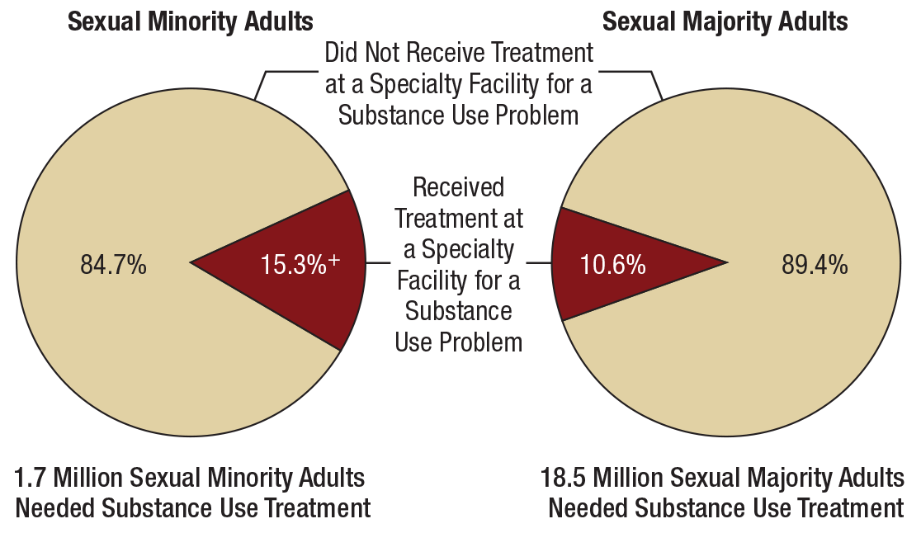
Background

Slide 5
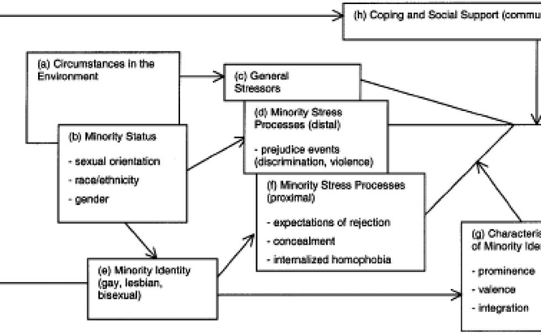
Why?

Slide 6
More Reasons Why
Not feeling connected
Lack of social relationships
Acceptance by peers
To relieve ‘numbness’
Increased sexual performance
To have ‘fun’

Slide 7
Current Status of Harm Reduction

Slide 8
What is Harm Reduction?
Harm reduction is a pragmatic approach to reduce the harmful consequences of drug use and other high-risk activities by incorporating several strategies that cut across the spectrum from safer use to managed use to abstinence.
The primary goal of most harm-reduction approaches is to meet individuals where they are at and not to ignore or condemn the harmful behaviors, but rather to work with the individual or community to minimize the harmful effects of a given behavior.
Tatarsky (2003): “The essence of harm reduction is the recognition that treatment must start from the client's needs and personal goals and that all change that reduces the harms associated with substance use can be regarded as valuable.”

Slide 9
Current Programs
Policy issues
Supply-reduction
Demand reduction
Awareness campaigns
Preventive interventions
Community social support
Needle-syringe
Safe-injection
School-based
Screening
There are no programs designed to treat substance use among sexual minorities.

Slide 10
Where do we need to go?
Individual Level
Community Level
School Level

Slide 11
Individual Level
Humanism
Respect and care for individuals
People do things for a reason
Approaches: Services are user-friendly, providers accept patients’ choices, understand why it happened using non-judgment.
Individualism
Everyone is unique!
Approaches: Strengths and needs are assessed for each patient, and no assumptions are made based on harmful health behaviors.
Incrementalism
Every step is important!
Positive reinforcement

Slide 12
School Level
Implement and enforce comprehensive antibullying policies that enumerate sexual orientation and gender identity/expression.
Approaches: Teaching students to accept students, be their friends, enforcement of policies, reduction of stigma
Comprehensive drug education
Approaches: Teaching students the harms of drugs, the effects on different populations, etc.

Slide 13
Community Level
Prevention policies:
Community support
Education
Focus groups
Approaches: Motivational interviewing
Identification of risk factors
Signs highlighting substance use harms

Slide 14
Where do we need to go?
More research is needed to see how harm reduction works in SGM populations.
Better understanding of the needs and services in these populations.

Slide 15
Conclusions
Substance use remains a critical problem in LGBT+ communities.
Harm reduction strategies need to have a humanistic component.

